Slide 1
Presentation
4
I choose to design an interactive app that facilitates people sharing images and feelings about renting a house, gets immediate feedback, and provides people in need with free tools or furniture.
The housing app is created with a user-friendly interface that fosters trust, community interaction, and resource sharing, ultimately generating revenue through customers paying membership fees to get advanced suggestions from professional experts to successfully rent a house.
Wenxuan Xia

Slide 2

Reason:
We are in the era of the Internet facing various changes and we need an efficient platform to help us gather some information about renting a house. We face a crisis in many of our most productive cities, with skyrocketing housing costs driving poverty, inequality, and epidemic homelessness. Two out of three people worldwide are projected to live in urban areas by 2050 (Siliski, 2018). Many low-income Americans struggle with housing problems and roughly 23 million people in low-income households pay more than half of their income for rent, for example, and approximately 1.3 million school-age children live in shelters, on the street, doubled up with other households, or in hotels or motels (Will et al., 2019). Therefore, it will be a big problem for people seeking a house to live at a normal price.
A more important solution is that people with abundant experience can share their information with new home-seekers to break the barrier of getting news of housing. Teenagers, for example, can communicate with each other in an app to discuss a problem or a new phenomenon occurring in the process of searching and living in rented houses and give each other useful advice or get some advice from professional people.

Slide 3
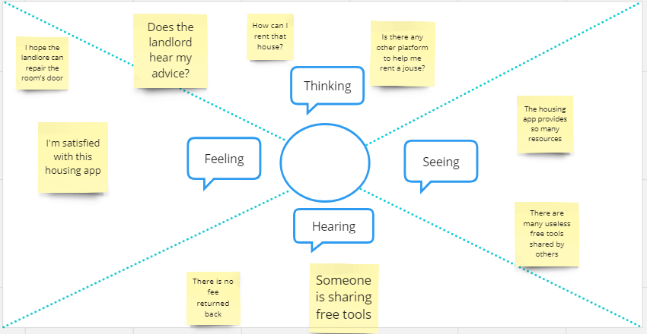
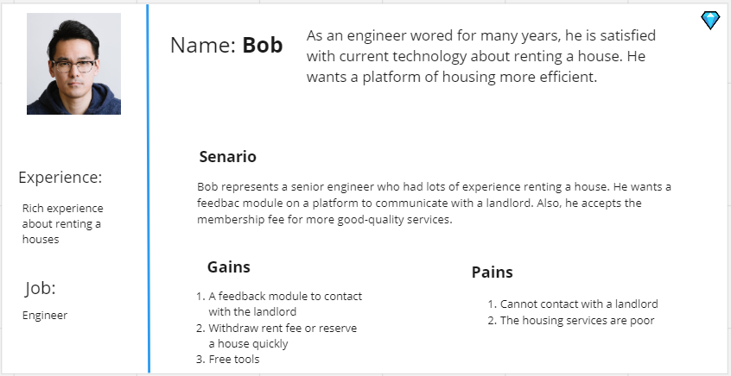
Empathizing
Feedback
Efficiency

Slide 4
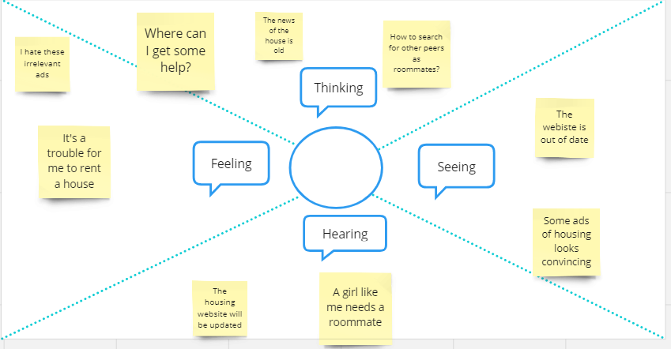
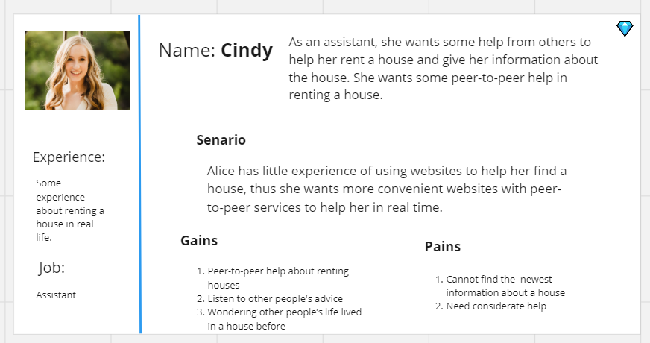
Empathizing
Experience
Peer-to-peer help
Sharing feelings

Slide 5
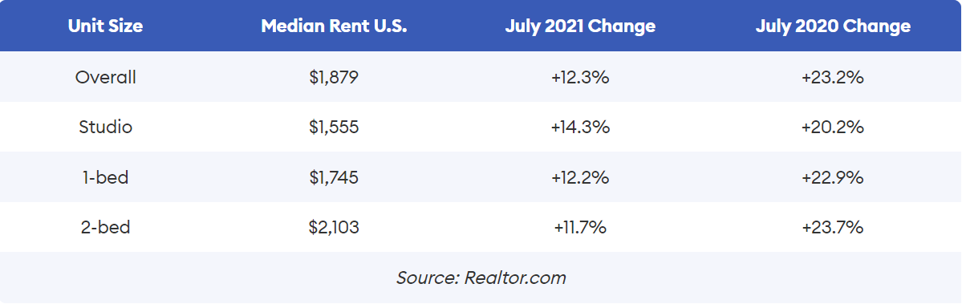

Second research
An interactive ICT platform was acceptable and user friendly, and it emphasizes that relevant technology may promote independence (Algilani et al., 2017).
“With the mobile requirement of population and ownership, the disruptive digital housing platform emerges as an online flexible and interactive information medium (Jiang and Wang, 2023:16).”
“The median price for rent across the country jumped by 12.3% in July from July 2021 and was up by 23.2% from July 2020. It stands at an eye-watering $1,879 per month (Campisi, 2022).”
The requirement of an interactive housing platform
Tenants preparing to relocate encounter a surge in rental costs. The cost of new leases is raised by an extra $300 or higher each month in contrast to the $160 per month for extending an ongoing lease. Such exorbitant increases in rent can either confine renters to unsuitable apartments or let them forgo moving closer to their workplace or educational institution. (Campisi, 2022).
The urgency of solving the problem of housing

Slide 6
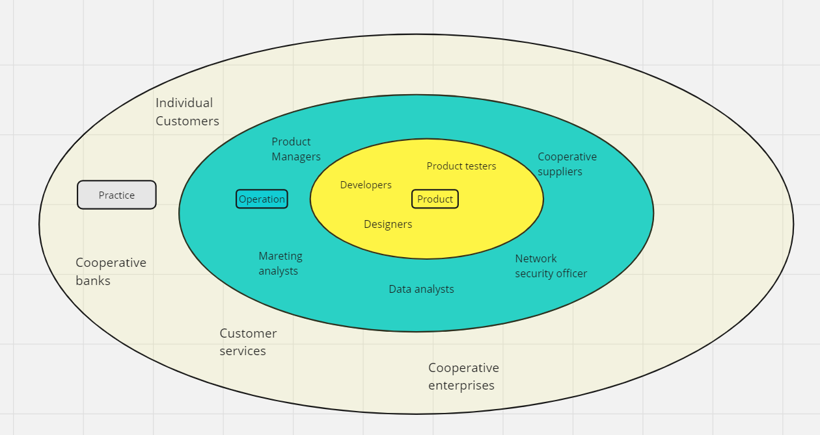
Stakeholder map

Slide 7


Defining
Bob is a 33-year-old engineer who is not satisfied with the efficiency of housing apps. He needs to find an efficient platform to help him rent or reserve a good-quality house because he wants to maximize his chance to rent the next house if the deposit can be withdrawn from the former landlord on the platform.
Cindy is a 25-year-old assistant who lacks help from others to rent a house. She needs some peer-to-peer help so that she can get the newest information about renting a house and she wants to know other people’s lives living in a new house.
POV Statement

Slide 8

5 whys
Why is it happening?
Why this problem happens can be analyzed through users’ common requirements. Most users of a housing app want to get helpful information to help them achieve their requirements for renting a house.
Why is that?
They clearly know their objectives to rent a house to live.
Why is that?
They may be a bit anxious about such requirements for limited houses.
Why is that?
They lack some help or advice from other experienced people and they don’t know how to search for effective information.
Why is that?
Most users are alone with limited experience of renting houses or with little interaction with others.
Define the problem
The problems occurring among these people can be summarized into one problem: how to get some valuable information about renting a house.

Slide 9

Problem statement
From the interview and research, I know that people are facing a severe problem in searching for effective housing resources via a good platform, which causes housing resources wasted and lowers people’s sense of happiness.
It’s important to distinguish different weak points of those users to help them solve housing problems and to know people’s requirements for a platform to share information with each other.

Slide 10
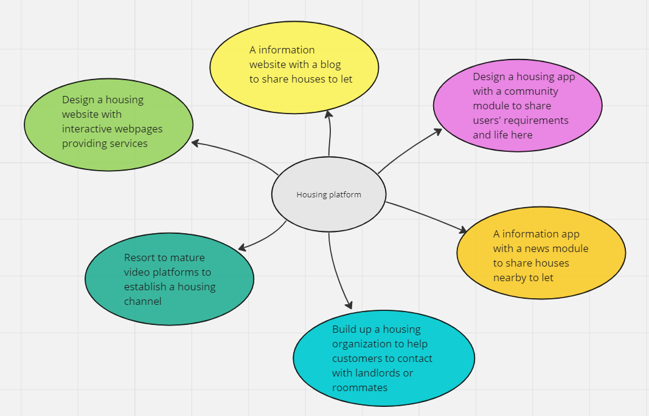
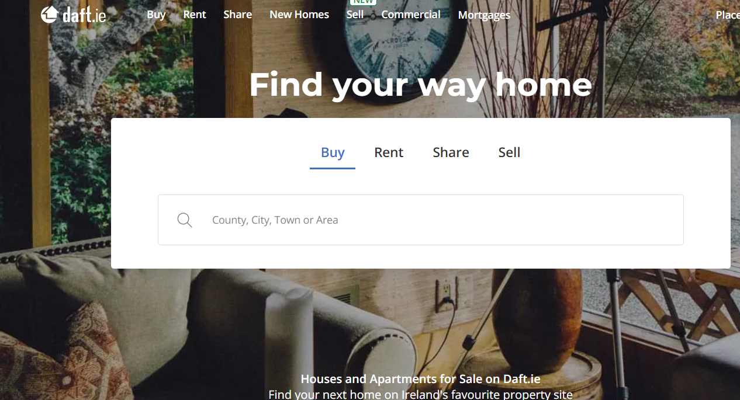
Ideation
A mobile app with an interactive community module will give users peer-to-peer help and attract people searching for houses or getting free resources and advice for the newest housing information.
People can share with each other their daily lives via sending pictures or sharing feelings in the module and invite their friends having the same trouble to join them in using the app and get professional suggestions by paying membership fees.

Slide 11
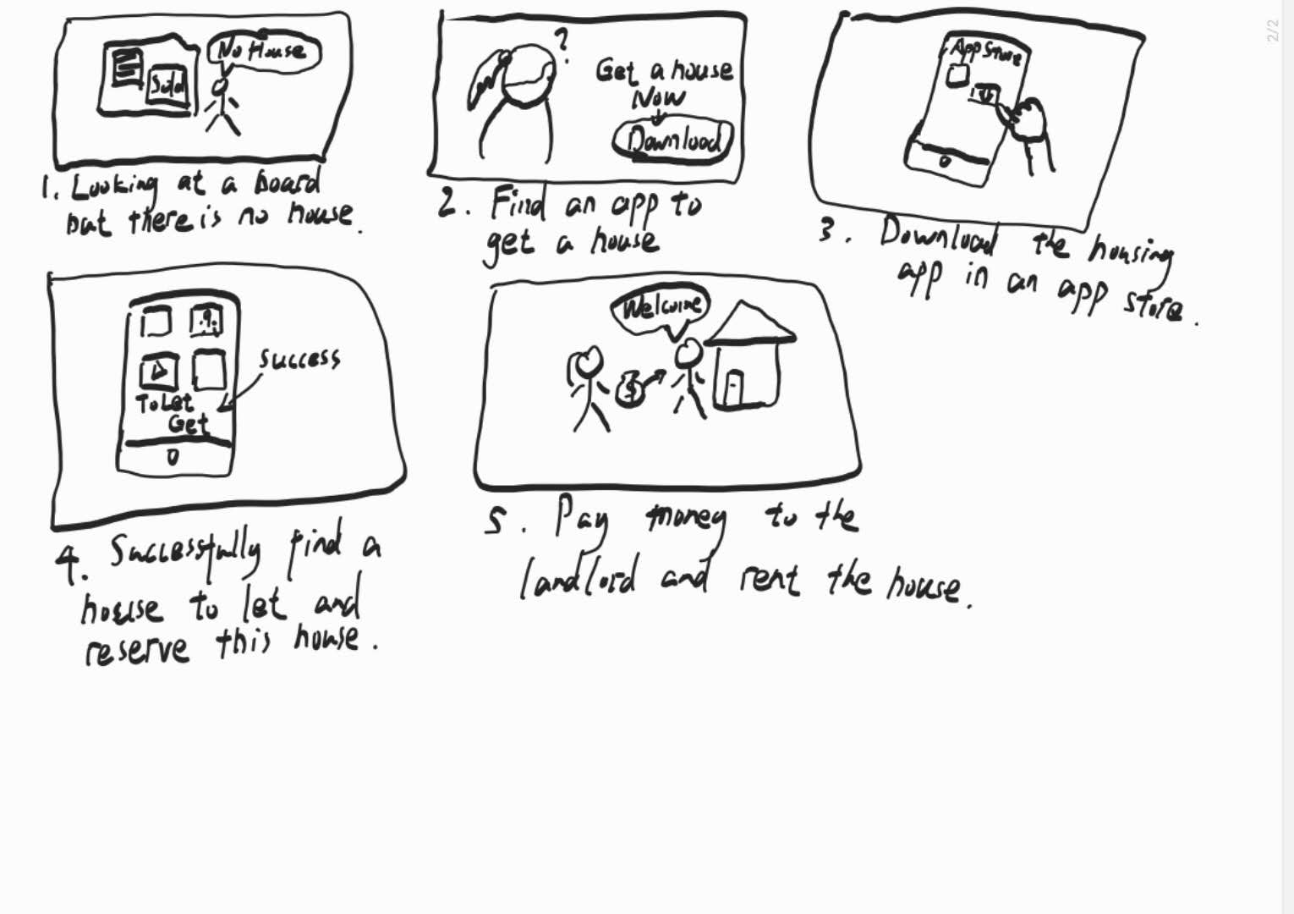
Storyboard

Slide 12
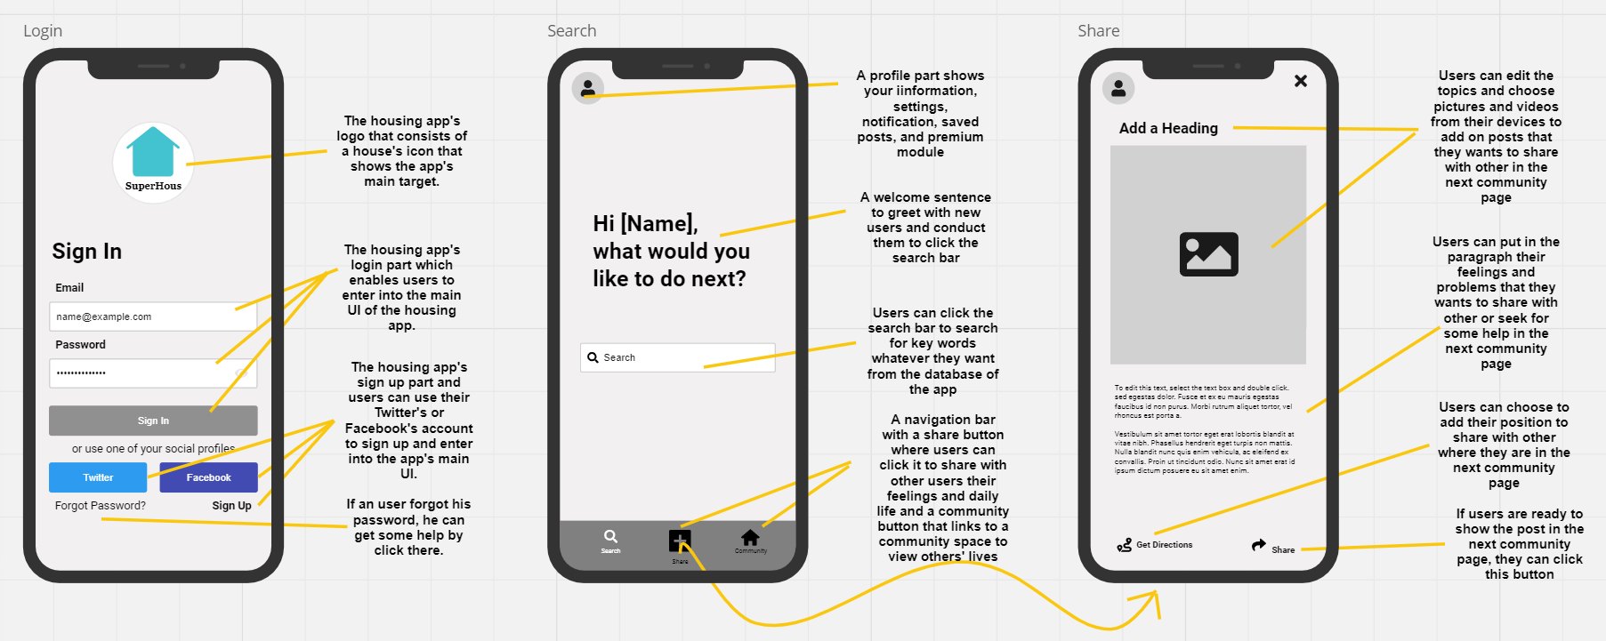
Wireframes

Slide 13
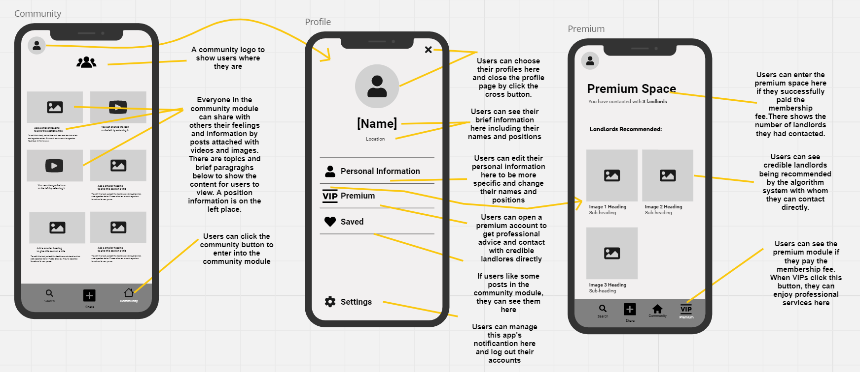
Wireframes

Slide 14
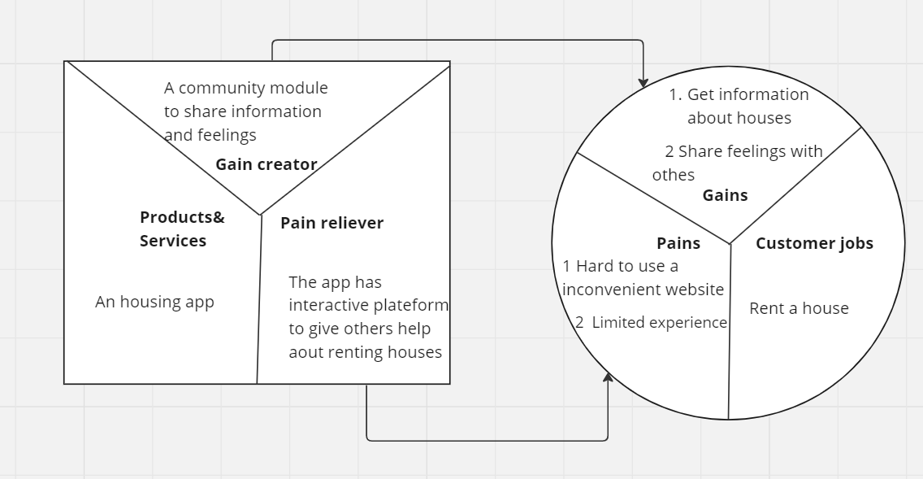
Value proposition map
The housing app is designed to streamline the traditional way of searching for a house by collecting information in heterogeneous ways and it facilitates people’s interaction like sharing feelings to give those searching for a house some help.

Slide 15
Algilani, S., Langius-Eklöf, A., Kihlgren, A. and Blomberg, K. (2017) ‘An interactive ICT platform for early assessment and management of patient-reported concerns among older adults living in ordinary housing - development and feasibility’, Journal of Clinical Nursing, 26(11-12),
Jiang, W. and Wang, J. (2023) ‘Autonomous Collective Housing Platform: Digitization, Fluidization and Materialization of Ownership’, Blucher Design Proceedings, 11(2).
Siliski, M. (2018) A Housing Platform, Medium. Available at: https://msiliski.medium.com/housing-platform-17f6fc349382 (Accessed: 27 October 2023).
Will, F., Douglas, R., Alicia, M. (2019) Reseach Shows Rental Assistance Reduces Hardship and Provides Platform to Expand Opportunity for Low-Income Families. Available at: https://www.cbpp.org/research/housing/research-shows-rental-assistance-reduces-hardship-and-provides-platform-to-expand#_edn1 (Accessed: 5 December 2019).
Than you!
Campisi, N. (2022) Why The U.S. Rental Housing Crisis Is So Dire – Forbes Advisor, www.forbes.com. Available at: https://www.forbes.com/advisor/personal-finance/rental-housing-costs-rise/.

